Slide 1
How to create a QUESTIONNAIRE? (வினாக்கொத்தொன்றை தயாரிப்பது எவ்வாறு?)
Mr. ACM. Nafrees
Instructor, FIA, SEUSL
Notes:
NOTE:
To change the image on this slide, select the picture and delete it. Then click the Pictures icon in the placeholder to insert your own image.

Slide 2
Agenda
Data Collection Methods
Develop a Questionnaire for a Research
Online Survey Tools for Create questionnaire
Sampling methods

Slide 3
Data Collection Methods

Slide 4
Data Collection Methods & Tools For Research
The underlying need for Data collection is to capture quality evidence.
To improve the quality of information, it is expedient that data is collected so that you can draw inferences and make informed decisions on what is considered factual.

Slide 5
What is Data Collection?
Data collection is a methodical process of gathering and analyzing specific information to proffer solutions to relevant questions and evaluate the results.
key purpose to make predictions about future probabilities and trends.

Slide 6
Type of Data Collection
Primary Data Collection
Qualitative research method
Quantitative research method
Secondary Data Collection
Notes:
Primary Data Collection
Primary data collection by definition is the gathering of raw data collected at the source. It is a process of collecting the original data collected by a researcher for a specific research purpose. It could be further analyzed into two segments; qualitative research and quantitative data collection methods.
Secondary Data Collection
Secondary data collection, on the other hand, is referred to as the gathering of second-hand data collected by an individual who is not the original user. It is the process of collecting data that is already existing, be it already published books, journals and/or online portals. In terms of ease, it is much less expensive and easier to collect.
Your choice between Primary data collection and secondary data collection depend on the nature, scope and area of your research as well as its aims and objectives.

Slide 7
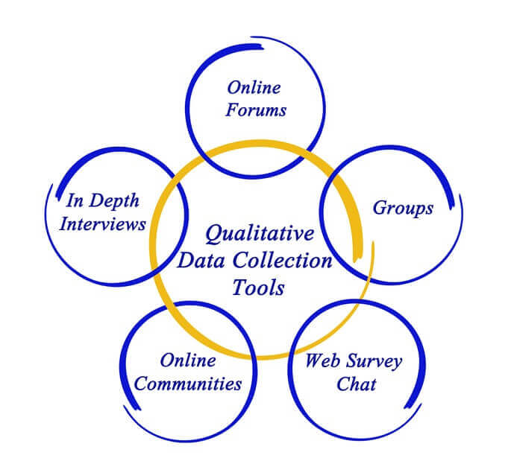
Primary data collection: Qualitative Research Method
The qualitative research methods of data collection does not involve the collection of data that involves numbers or a need to be deduced through a mathematical calculation, rather it is based on the non-quantifiable elements like the feeling or emotion of the researcher.
An example of such a method is an open-ended questionnaire.

Slide 8
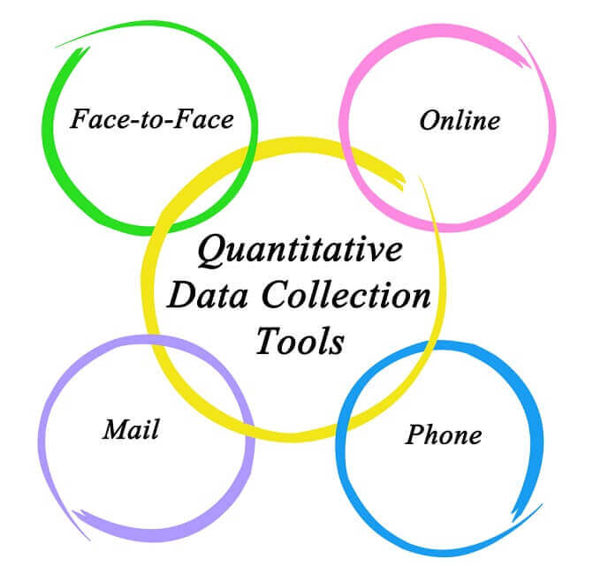
Primary data collection: Quantitative Research Method
Quantitative methods are presented in numbers and require a mathematical calculation to deduce.
An example would be the use of a questionnaire with close-ended questions to arrive at figures to be calculated Mathematically.
Also, methods of correlation and regression, mean, mode and median.

Slide 9
Data Collection Methods
Interviews
An interview is a face-to-face conversation between two individuals with the sole purpose of collecting relevant information to satisfy a research purpose.
Structured
Semi-structured
Unstructured
Tools
Audio Recorder
Digital Camera
Camcorder

Slide 10
Data Collection Methods
2. QUESTIONNAIRES
This is the process of collecting data through an instrument consisting of a series of questions and prompts to receive a response from individuals it is administered to. Questionnaires are designed to collect data from a group.
fixed-alternative
Scale
open-ended
Tools:
Online forms
Paper Questionnaire

Slide 11
Data Collection Methods
3. Reporting:
data reporting is the process of gathering and submitting data to be further subjected to analysis.
Tools
NGO Reports
Newspaper
Website Article
Hospital care records

Slide 12
Data Collection Methods
4. Existing Data:
This is the introduction of new investigative questions in addition to/other than the ones originally used when the data was initially gathered.
It involves adding measurement to a study or research.
An example would be sourcing data from an archive.
Tool
Research Journal
Surveys

Slide 13
Data Collection Methods
4. Observations:
This is a data collection method by which information on a phenomenon is gathered through observation.
complete observer
Participants
Participant as an observer
complete participant.
Tools
Checklist
Direct Observations

Slide 14
Data Collection Methods
6. Focus Groups:
Focuses more on qualitative research.
Primary category for data based on the feelings and opinions of the respondents.
This research involves asking open-ended questions to a group (6-10)
Tools:
Two-way
Dueling Moderator

Slide 15
Data Collection Methods
7. Combined Methods:
This method of data collection encompasses the use of innovative methods to enhance participation to both individuals and groups.
Primary category
Combination of Interviews and Focus Groups while collecting qualitative data.
Tools:
Online Survey
Dual-Moderator

Slide 17
Develop a Questionnaire for a Research

Slide 18
Develop Questionnaires
A questionnaire is a technique for collecting data in which a respondent provides answers to a series of questions.
To develop a questionnaire that will collect the data you want takes effort and time.
By taking a step-by-step approach to questionnaire development, you can come up with an effective means to collect data that will answer your unique research question.
Designing your Questionnaire
Writing the Questionnaire
Distributing your Questionnaire

Slide 19
Develop Questionnaires: Designing your Questionnaire

Slide 20
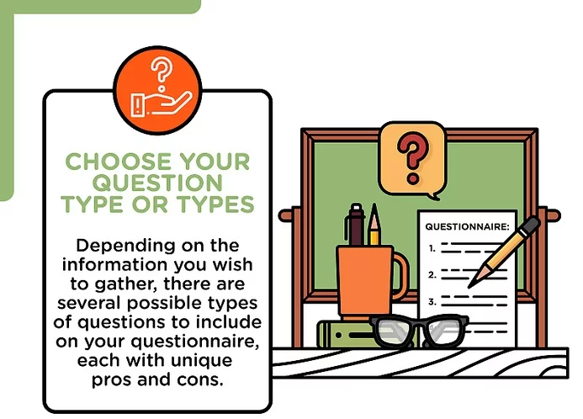
Develop Questionnaires: Choose your question type or types
Dichotomous question.
Open-ended questions
Multiple choice questions
Rank-order (or ordinal) scale questions
Rating scale questions

Slide 21
Develop Questionnaires: Develop Questions for your Questionnaire

Slide 22
Develop Questionnaires: Restrict the length of Questionnaire

Slide 23
Develop Questionnaires: Identify your Target Demographic

Slide 24
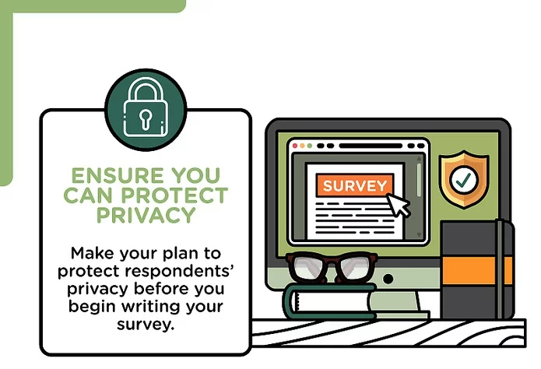
Develop Questionnaires: Ensure you can Protect Privacy

Slide 25
Writing your Questionnaire: Introduce yourself

Slide 26
Writing your Questionnaire: Explain the Purpose of the Questionnaire

Slide 27
Writing your Questionnaire: Reveal what will happen with the Data you collect

Slide 28
Writing your Questionnaire: Estimate how long the Questionnaire will take

Slide 29
Writing your Questionnaire: Make sure your Questionnaire looks Professional

Slide 30
Distributing your Questionnaire: Do a Pilot study

Slide 31
Distributing your Questionnaire: Disseminate your Questionnaire

Slide 32
Distributing your Questionnaire: Include a Deadline

Slide 33
Online Survey Tools for Create questionnaire

Slide 34
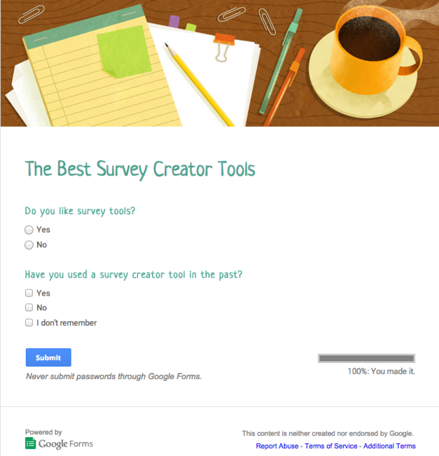
Online Survey Tools
Paid
Free

Slide 35
Online Survey Tools
SoGoSurvey
Survey Monkey
Typeform
Google Forms
Client Heartbeat
Zoho Survey
Survey Gizmo
Survey Planet

Slide 36
Sampling Method

Slide 37
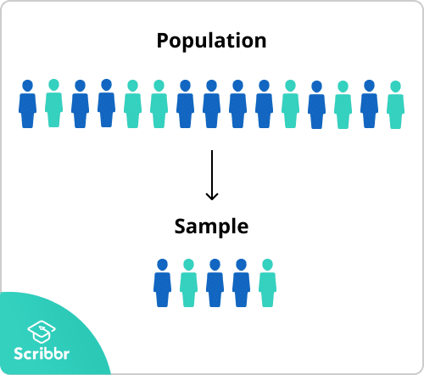
Sampling
When you conduct research about a group of people, it’s rarely possible to collect data from every person in that group. Instead, you select a sample.
The sample is the group of individuals who will actually participate in the research.
Two Methods:
Probability sampling
Non-probability sampling
Population vs Sample
Sample size calculator

Slide 38
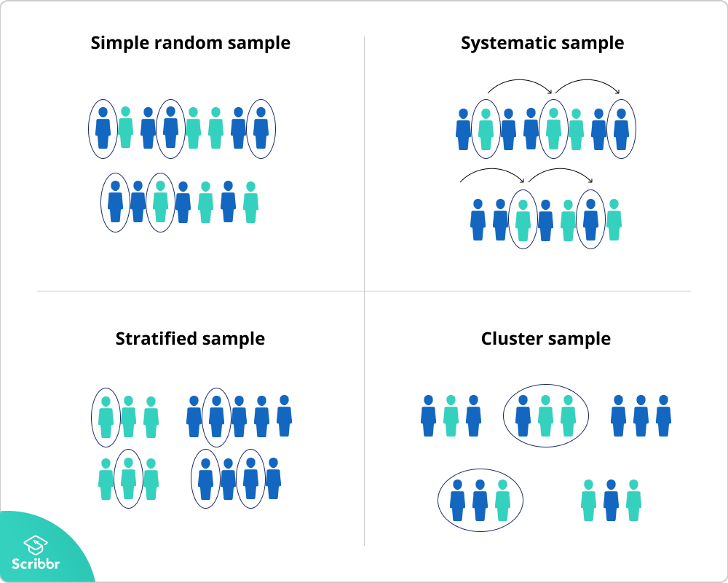
Sampling Method: Probability sampling
every member of the population has a chance of being selected.
Mainly used in quantitative research.
Produce results that are representative of the whole population.

Slide 39
Sampling Method: Probability sampling: Simple random sampling
n a simple random sample, every member of the population has an equal chance of being selected. Your sampling frame should include the whole population.
To conduct this type of sampling, you can use tools like random number generators or other techniques that are based entirely on chance.
Example: You want to select a simple random sample of 100 employees of Company X. You assign a number to every employee in the company database from 1 to 1000, and use a random number generator to select 100 numbers.

Slide 40
Sampling Method: Probability sampling: Systematic sampling
Every member of the population is listed with a number, but instead of randomly generating numbers, individuals are chosen at regular intervals.
Example: All employees of the company are listed in alphabetical order. From the first 10 numbers, you randomly select a starting point: number 6. From number 6 onwards, every 10th person on the list is selected (6, 16, 26, 36, and so on), and you end up with a sample of 100 people.

Slide 41
Sampling Method: Probability sampling: Stratified sampling
divide the population into subgroups (called strata) based on the relevant characteristic (e.g. gender, age range, income bracket, job role).
Based on the overall proportions of the population, calculate how many people should be sampled from each subgroup. Then you use random or systematic sampling to select a sample from each subgroup.
Example: The company has 800 female employees and 200 male employees. You want to ensure that the sample reflects the gender balance of the company, so you sort the population into two strata based on gender. Then you use random sampling on each group, selecting 80 women and 20 men, which gives you a representative sample of 100 people.

Slide 42
Sampling Method: Probability sampling: Cluster sampling
involves dividing the population into subgroups, but each subgroup should have similar characteristics to the whole sample.
Instead of sampling individuals from each subgroup, you randomly select entire subgroups.
If it is practically possible, you might include every individual from each sampled cluster.
If the clusters themselves are large, you can also sample individuals from within each cluster using one of the techniques above.
Example: The company has offices in 10 cities across the country (all with roughly the same number of employees in similar roles). You don’t have the capacity to travel to every office to collect your data, so you use random sampling to select 3 offices – these are your clusters.

Slide 43
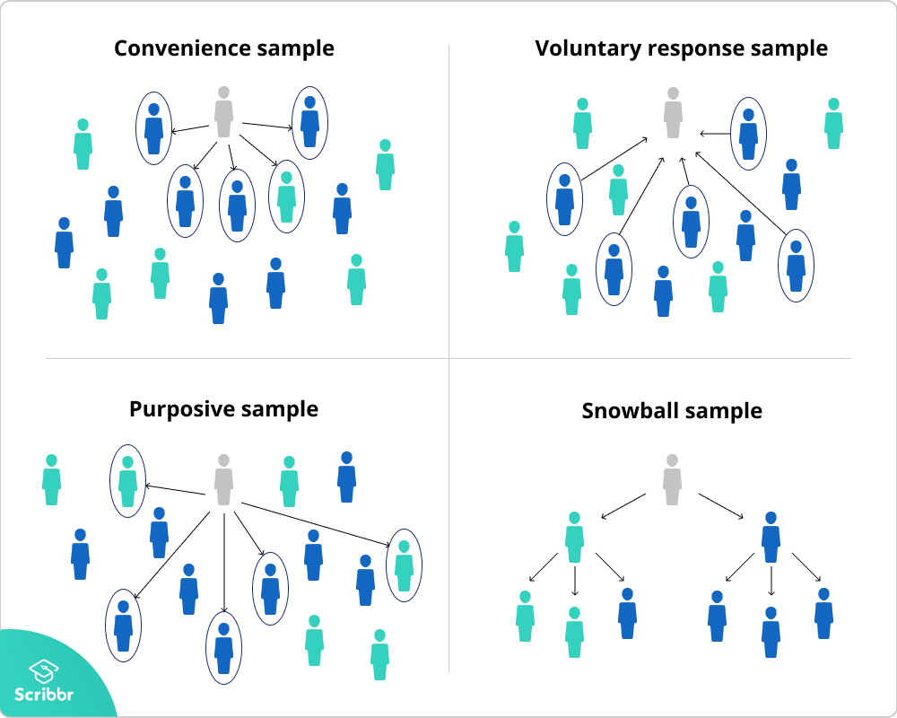
Sampling Method: Non-probability sampling methods
In a non-probability sample, individuals are selected based on non-random criteria, and not every individual has a chance of being included.
appropriate for exploratory and qualitative research.

Slide 44
Sampling Method: Non-probability sampling methods: Convenience sampling
A convenience sample simply includes the individuals who happen to be most accessible to the researcher.
Example: You are researching opinions about student support services in your university, so after each of your classes, you ask your fellow students to complete a survey on the topic. This is a convenient way to gather data, but as you only surveyed students taking the same classes as you at the same level, the sample is not representative of all the students at your university.

Slide 45
Sampling Method: Non-probability sampling methods: Voluntary response sampling
Similar to a convenience sample, a voluntary response sample is mainly based on ease of access. Instead of the researcher choosing participants and directly contacting them, people volunteer themselves (e.g. by responding to a public online survey).
Example: You send out the survey to all students at your university and a lot of students decide to complete it. This can certainly give you some insight into the topic, but the people who responded are more likely to be those who have strong opinions about the student support services, so you can’t be sure that their opinions are representative of all students.

Slide 46
Sampling Method: Non-probability sampling methods: Purposive sampling
This type of sampling involves the researcher using their judgement to select a sample that is most useful to the purposes of the research.
Example: You want to know more about the opinions and experiences of disabled students at your university, so you purposefully select a number of students with different support needs in order to gather a varied range of data on their experiences with student services.

Slide 47
Sampling Method: Non-probability sampling methods: Snowball sampling
If the population is hard to access, snowball sampling can be used to recruit participants via other participants.
Example: You are researching experiences of homelessness in your city. Since there is no list of all homeless people in the city, probability sampling isn’t possible. You meet one person who agrees to participate in the research, and she puts you in contact with other homeless people that she knows in the area.

Slide 49
Any Queries…???

Slide 50
Thank You

