Slide 1
RESEARCH and its importance
Dr. SMM. mazahir
Dean/fia/seusl
14.06.2020

Slide 2
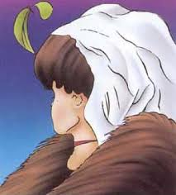

Slide 3
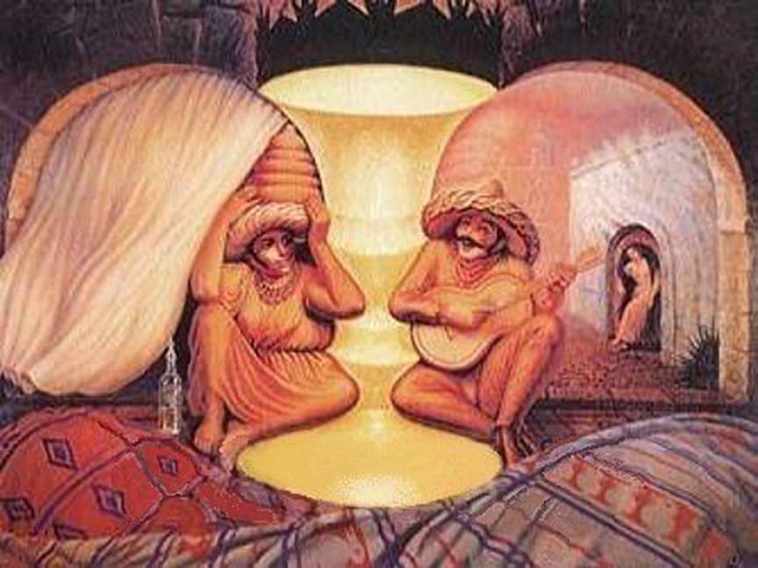

Slide 4
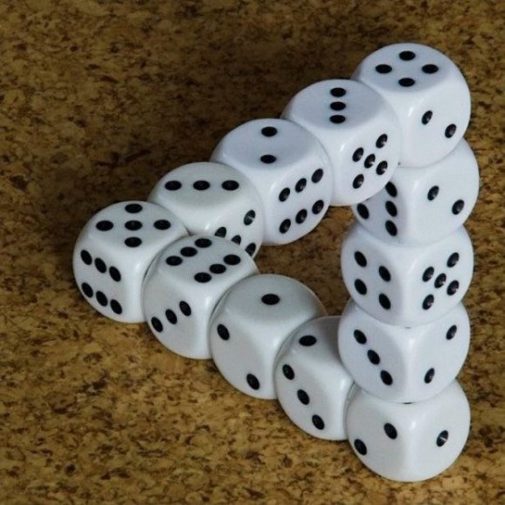

Slide 5
What is Research? Ma;T vd;why; vd;d?
Research is Re-Search
Generally, research is the organized and systematic method of finding answers to questions.
Systematic investigative process employed to increase or revise current knowledge or to discover new knowledge by discovering new facts.

Slide 6
Ma;Tf;F ,];yhk; nfhLj;Js;s Kf;fpaj;Jtk;
my;FHMd; Ma;Tf;F toq;fpAs;s Kf;fpaj;Jtk;
(ghjpH-28) (My ,k;uhd; 191) (my;qh]pah 17-20)
وَمِنَ ٱلنَّاسِ وَٱلدَّوَآبِّ وَٱلأَنْعَامِ مُخْتَلِفٌ أَلْوَانُهُ كَذَلِكَ إِنَّمَا يَخْشَى ٱللَّهَ مِنْ عِبَادِهِ ٱلْعُلَمَاءُ إِنَّ ٱللَّهَ عَزِيزٌ غَفُورٌ
ٱلَّذِينَ يَذْكُرُونَ ٱللَّهَ قِيَاماً وَقُعُوداً وَعَلَىٰ جُنُوبِهِمْ وَيَتَفَكَّرُونَ فِي خَلْقِ ٱلسَّمَٰوَٰتِ وَٱلأَرْضِ رَبَّنَآ مَا خَلَقْتَ هَذا بَاطِلاً سُبْحَانَكَ فَقِنَا عَذَابَ النَّارِ
أَفَلاَ يَنظُرُونَ إِلَى ٱلإِبْلِ كَيْفَ خُلِقَتْ

Slide 7
Ma;Tf;F ,];yhk; nfhLj;Js;s Kf;fpaj;Jtk;
egp (]y;) mtHfspd; `jP];fs;> nraw;ghLfs;
طلب العلم فريضة على كل مسلم
الحكمة ضالة المؤمن ......
`p[;uj;> mjd; gpd;duhd fzpg;gPL> njhlHe;j nraw;ghLfs;

Slide 8
Ma;T Vd; Njit? Why We Need Research?
To gather necessary information
To make changes
To improve standards of living
To ensure a safer life
To know the truth
To explore the history
To understand and appreciate arts

Slide 9
01. To Gather Necessary Information
Fwpg;gpl;l tplajhdk; njhlHghf mwpe;J nfhs;sy;. (ck;: ifNgrp ghtpj;jy;)
fk;gdpfspd; Muk;g Ma;Tfs; (re;ijg;gLj;jy; Nehf;fk;)
fw;wy;> fw;gpj;jy; Nehf;fq;fSf;fhf

Slide 10
02. To Make Changes
xU gpur;rpidapd; route cause If; fz;Lgpbj;J> khw;wj;ij Vw;gLj;jy;
Environmental Policies and Educational Policies
Use of polythene
Grade 5 scholarship examination

Slide 11
03. To Improve Standards of Living
Gjpa fz;Lgpbg;Gfs;
tPl;LgNahfg; nghUl;fs;
tho;it ,yFgLj;Jtjw;fhd topKiwfs; (Nghf;Ftuj;J rhjdq;fs;)

Slide 12
04. To Ensure A Safer Life
Health, Nutrition, Food Technology, Medicine ,y; Gjpa fz;Lgpbg;Gfs;> mtw;wpd; tsh;r;rp
mtw;wpd; %yk; ghJfhg;ghd tho;T – tho;tpd; vjph;ghh;f;if taJ mjpfhpj;jy;> MNuhf;fpaj;jpw;fhd trjpfs; mjpfupg;G
rpy Neha;fs; KOikahf ,y;yhnjhope;jik. (NghypNah> nghpak;ik> kNyupah..)
Nghf;Ftuj;J rhjdq;fspy; cs;s ghJfhg;G Vw;ghLfs;

Slide 13
05. To Know the Truth
gpioahd rpe;jidfisAk; nfhs;iffisAk; fUj;Jf;fisAk; Ghpe;J> mtw;wpd; cz;ikj; jd;ikia mwpe;J nfhs;sy;
mj;itjk;> Nrh\yp]k;> [dehafk;

Slide 14
06. To Explore the History
tuyhw;iw tFj;jy;> xOq;FgLj;jy; kw;Wk; epWTjy;
,yq;if K];ypk;fspd; tuyhW gw;wp Kd;itf;fg;gLk; re;Njfq;fs;
tuyhw;iw ikag;gLj;jp jpl;lkply;

Slide 15
07. To Understand and Appreciate Arts
fiy> ,yf;fpa tbtq;fs;> mofpaw; fiyfs; gw;wpa Ma;T
mtw;iwg; Ghptjw;Fk; ,urpg;gjw;Fk;
,oe;j fiyfis kPsf; nfhz;L tUtjw;F

Slide 16
Questions and Answers

